Slide 1
SUBWAY SYSTEM SIMULATOR
Team – A : Elite
Team Members:-
Prudvi Krishna Tarugu Subbaiah
Mahesh Babu Kadiyala
Vinay Banala
Grevil Gonsalo Lopes
Kranthi Kumar Mukka
Ghori Mohammad
Revathi Chittapureddy

Slide 2
Contents
Introduction
Project Briefing
Overview of the system
Prototypes
Use Cases
Challenges
Project Management Plan
Strategy
Estimation

Slide 3
Introduction
Developing subway system simulator with automated train system.
User sits at the dispatcher and overlooks the working of system.
Dispatcher can start or stop the system.
Notes:
safety

Slide 4
Project Briefing
Three main modules:
Subway trains
Tracks
Dispatcher
Notes:
sensors, front and back end

Slide 5
To be started
Safety:
Each and every train will check multiple times before taking a route.
Trains should stop by themselves, if any inappropriate situation occurs.
Dispatcher can stop the system using emergency stop control.

Slide 6
Requirements:
Automated train system should be developed by considering safety as main criteria
If user clicks on emergency button then entire train system should be stopped and If the user presses start button followed by emergency stop then the system will be restarted rather than resuming.
The trains and tracks communicate directly and dispatcher doesn’t do anything except enabling trains and tracks.

Slide 7
Requirements:
To start the simulator user need to provide only single input action by clicking START button located in the dispatcher
Other than user doesn’t do anything. He simply monitors the movement of the trains.
There should be a table on right panel in dispatcher which includes train and track information such as section number, section maximum speed and train number
If User clicks on train number of this right panel all other information about train should appear on another window
There should be a differentiation for each section, for identifying section easily

Slide 8
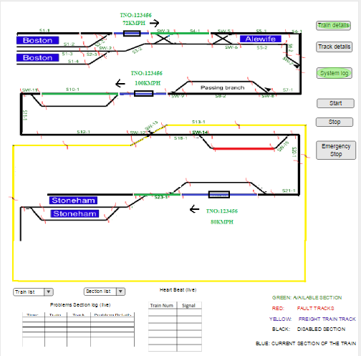
Dispatcher Prototype

Slide 9
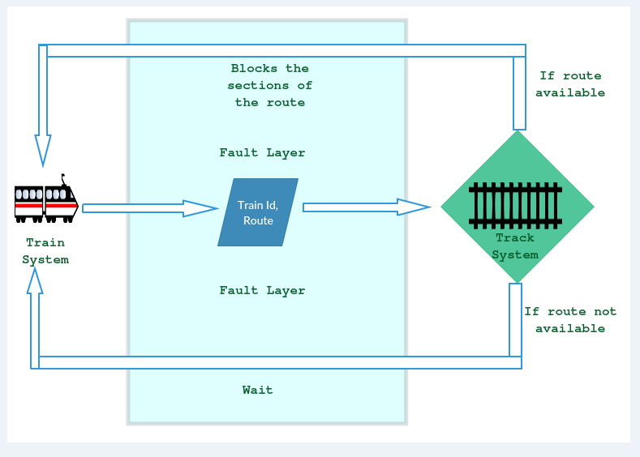

Slide 10
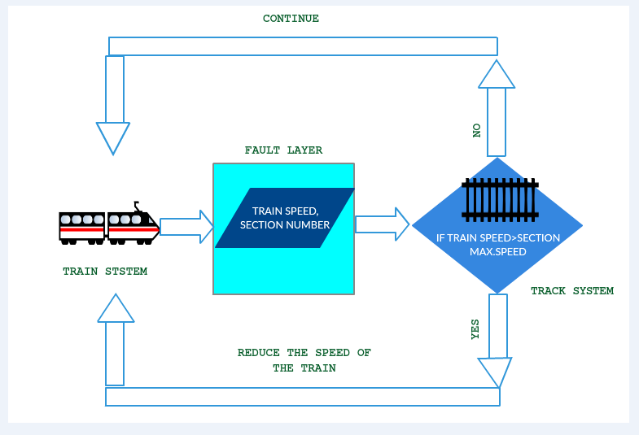

Slide 11
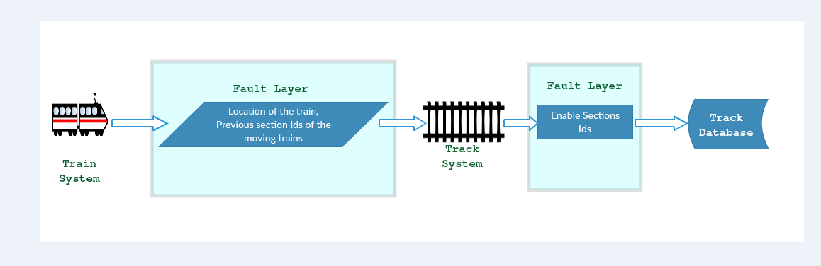

Slide 12
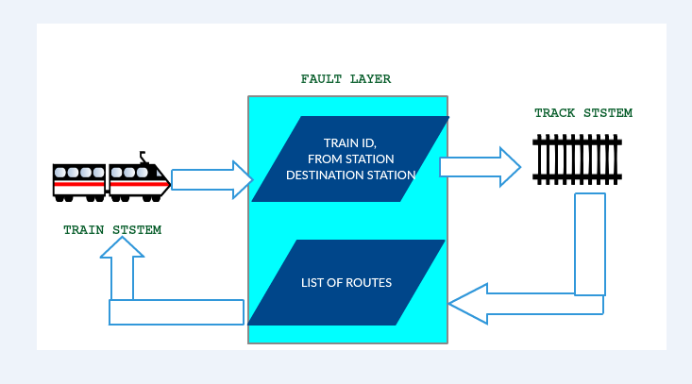

Slide 13
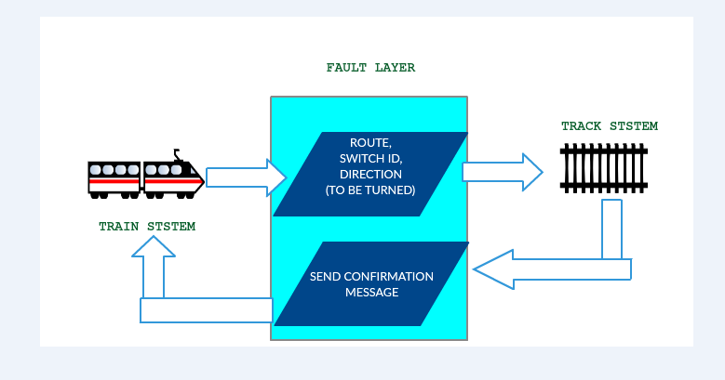

Slide 14
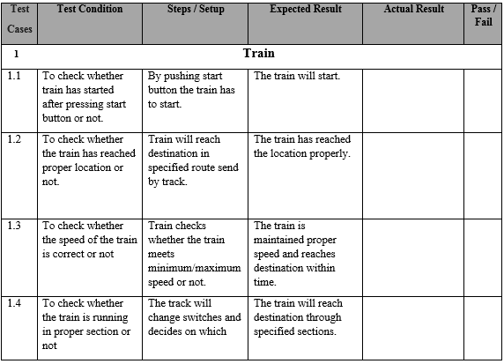

Slide 15
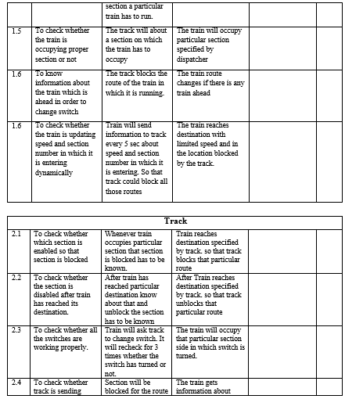

Slide 16
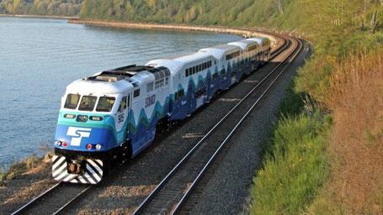
In Progress
Train System:
One train is implemented and is in testing phase.
Multiple trains, 3 More trains have to be implemented.
On client request, we are planning to add a table view to know more details of each individual train.

Slide 17
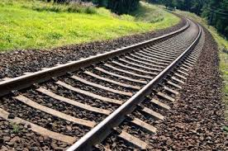
In Progress
Track System:
Track system was developed with reference with a map.
Maximizing the utilization of the space, with change in the placements of sections and switches.
A table view to display more information on each section of the track.

Slide 18
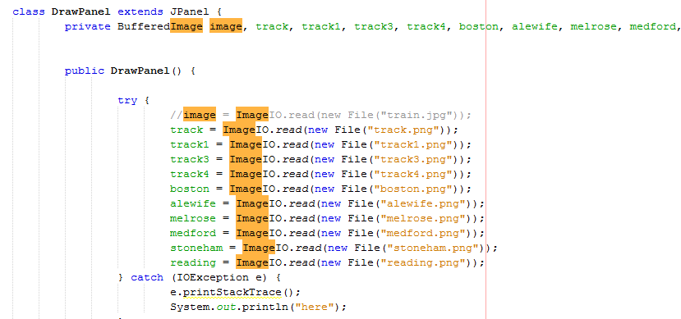
Code

Slide 19
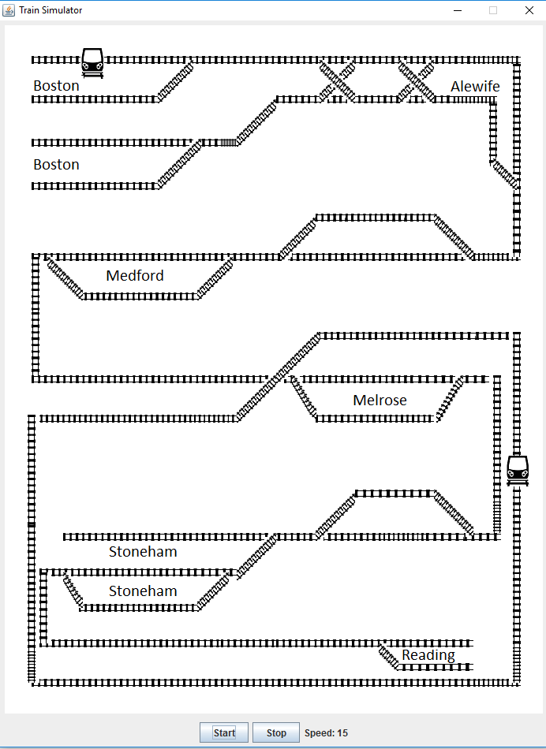
Overview of the System

Slide 20
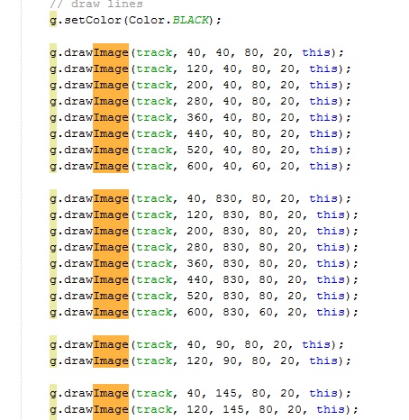

Slide 22
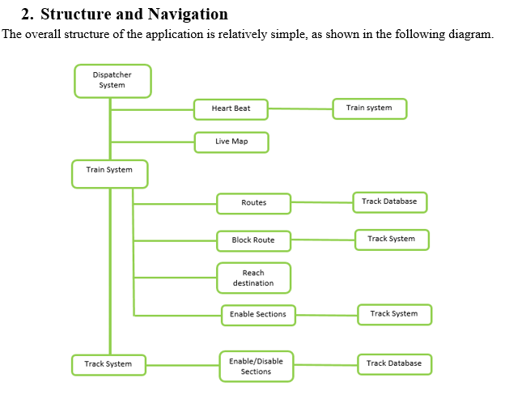
User Manual

Slide 23
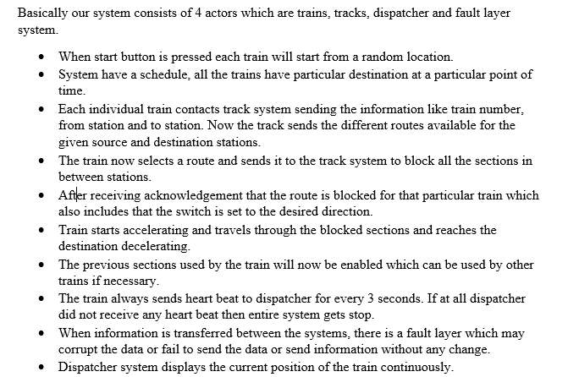
User Manual

Slide 24
CHALLENGES:
Linking the User interface with the Backend.
Implementing the fault layer.
Making the train stop by them selves.

Slide 25
Project Management Plan
Project Management Plan includes:
Scope Management Plan
Communication Management Plan
Cost management plan
Schedule management plan
Quality Management plan
Risk Management plan

Slide 26
Strategy
Firstly, we are planning to design a simulation with single train and track.
After that we will work on Graphical User Interface.
Then we will move on to the development of the entire system that consists of 4 trains.

Slide 27
Estimated efforts for completing project
We are working approximately 15 hours per week for every team member.
About 700 hours of combined team work in GDP 2.
We are completed with about 1000 lines of source code.
We are estimating another 2000 lines of code
Equal distribution of tasks among team members.

Slide 28
Thank You

